Slide 1

Smart Wheelchair Integrating Bluetooth and Health Monitoring System for Enhanced Mobility with Arduino Due
COEN 6711-F
Microprocessors and their Applications
Electrical and Computer Engineering
Fall 2023
26th November 2023
Pradheep Shankar (40240136)
Raghav Mohindru (40205963)
Neeraj Hampal (40195719)
Course Instructor – Dr. Fadi El Hassan

Slide 2
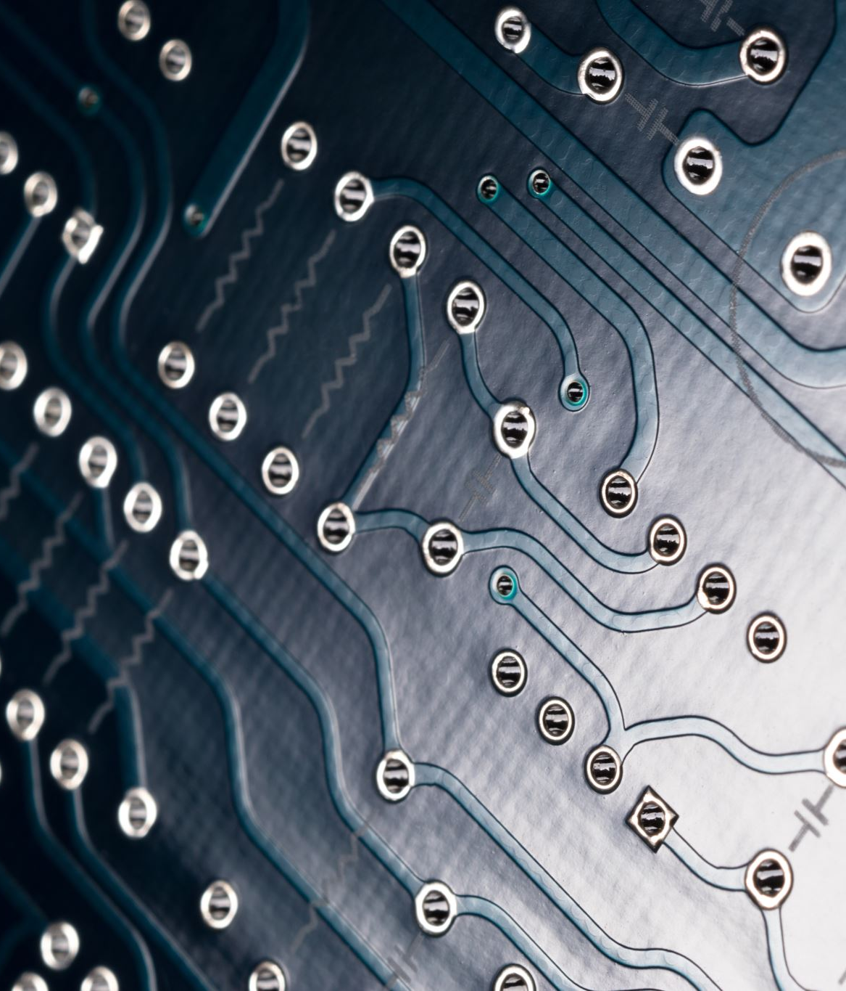
Index
Introduction
Problem Addressed
Proposed Solution
Objective
Implementation
Components Used
Hardware Design
Software Design
Results
Challenges Faced
Limitations
Future Scope
Conclusion
Demo Link

Slide 3

INTRODUCTION
Real Impact: Current estimate 1.9 million Canadians
Tech Progress: Advancing Wheelchairs
Innovation: Smart, Integrated Wheelchair
Health Tracking: Vital Signs Monitoring
Core System: Arduino Due Microcontroller
Sensors: 3 Types (Obstacle, Thermal, Health)
Wireless Control: Bluetooth
User Autonomy: Enhancing Independence
Health Scenario: Stroke Patient Support

Slide 4
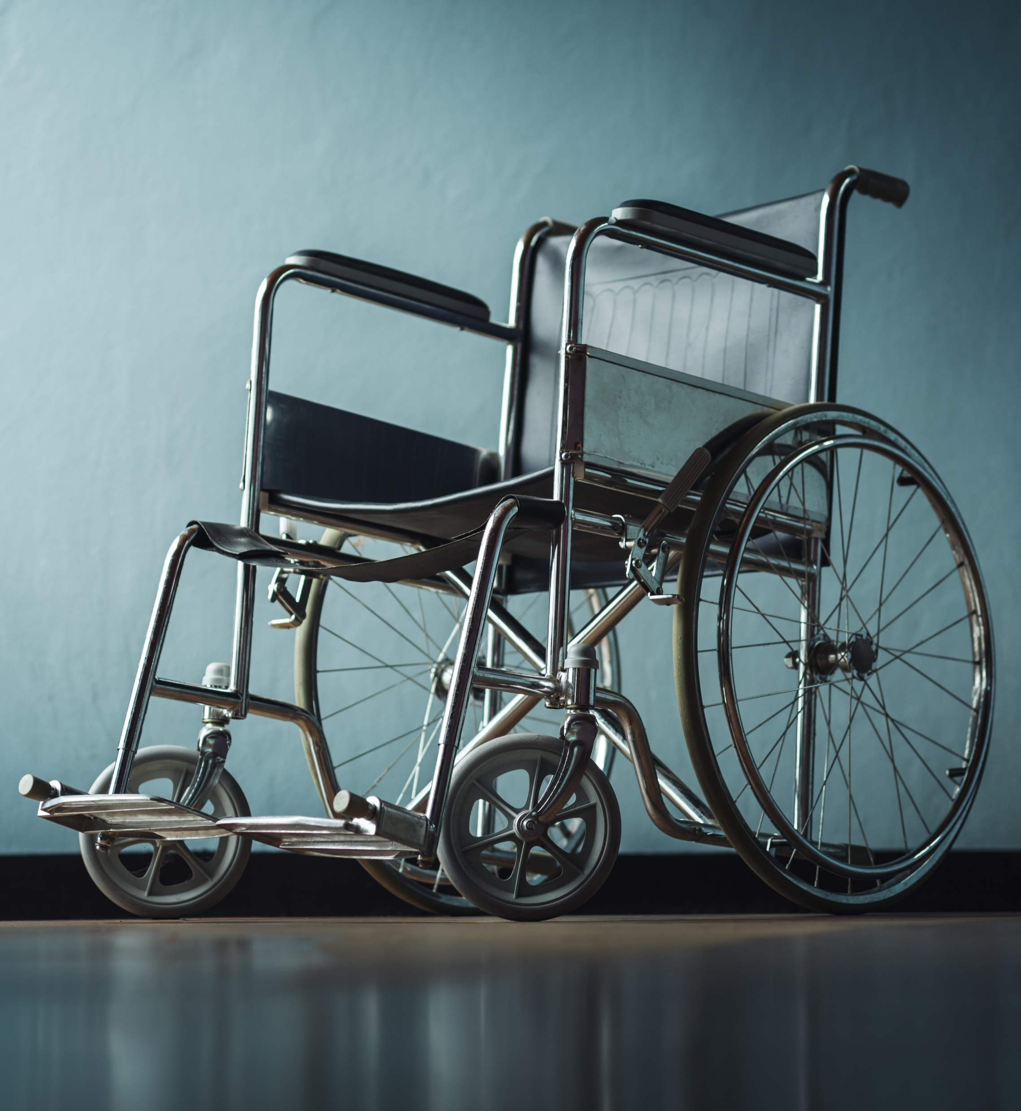
PROBLEM ADDRESSED
Global Need: Near 250 million people, face mobility issues
Mobility Challenges: Traditional wheelchairs limit independence.
Aging Population: Elderly require enhanced mobility solutions.
Health Monitoring: 40% of users need regular health checks.
Tech Integration Lag: Wheelchairs without smart health systems.
Project Goal: Modern tech for improved wheelchair functionality.

Slide 5

PROPOSED SOLUTION
Smart Wheelchair Design: Integrates health monitoring.
Arduino Due: Manages functionality.
Multi-Sensor Integration: For health and navigation.
Bluetooth: Enables remote operation.
Motor Driver: Facilitates precise mobility.
LCD Display: Shows health and navigation data.
Emergency Alerts: For critical health issues.
User-Centric Innovation: Combats wheelchair limitations.

Slide 6
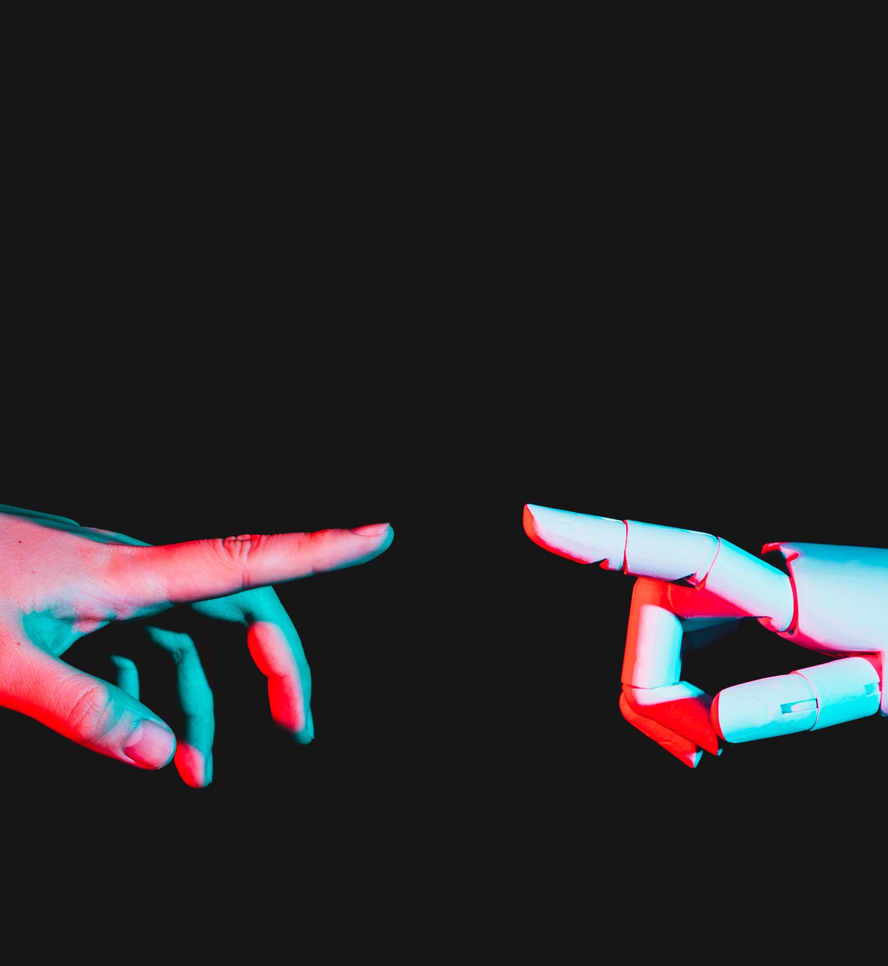
OBJECTIVE
Our project redefines assistive mobility by combining sophisticated control with seamless health monitoring, ensuring enhanced autonomy and safety for users in a compact, user-centric design.

Slide 7
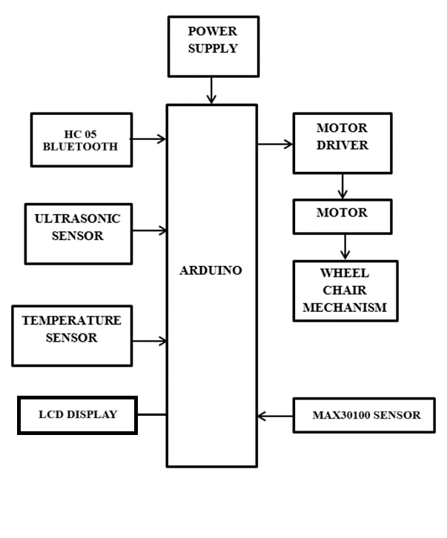
SYSTEM ARCHITECTURE
Integrate Advanced Mobility: Leverage Arduino Due for smart wheelchair enhancements.
Seamless Bluetooth Control: Implement HC-05 module for user-friendly navigation.
Comprehensive Health Monitoring: Utilize MAX30100 and DHT11 sensors for vital stats tracking.
User Experience Focus: Prioritize intuitive operation and safety.
Real-time Data Processing: Enable immediate response to environmental and health changes.
Prototype Demonstration: Showcase innovative features in a working model.

Slide 8
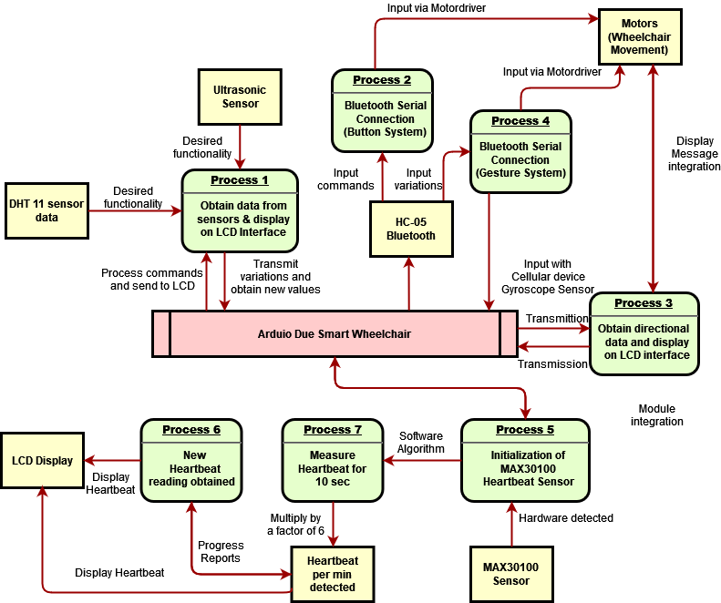
DESIGN FLOWCHART

Slide 9
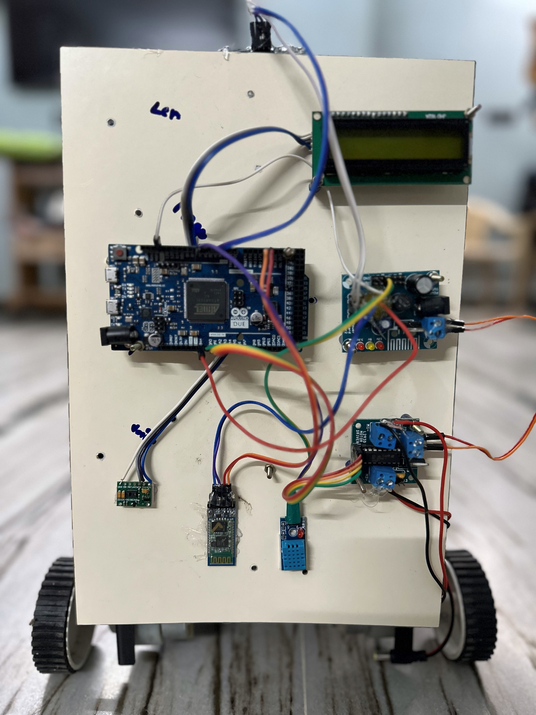
Hardware Requirements
Arduino Due
Ultrasonic sensor
Temperature sensor
Heartbeat Sensor
LCD display
Motor driver
Motor
Chasis or wheel chair mechanism
Power supply
Bluetooth Module

Slide 10
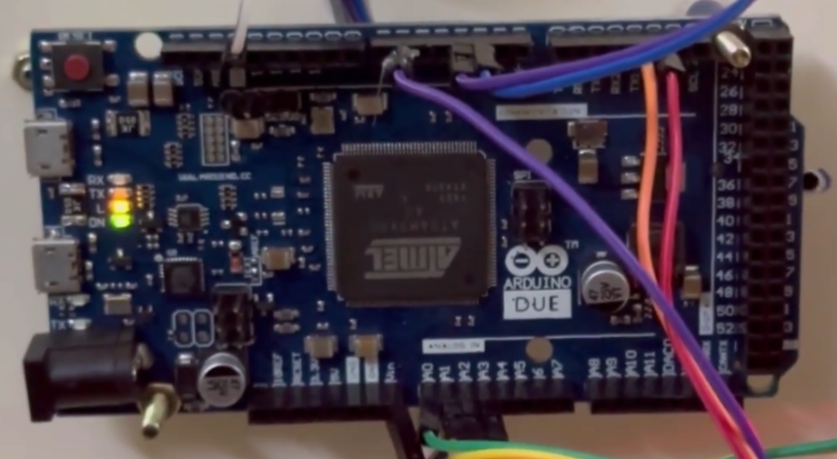
Hardware Requirements
Arduino Due
Advanced Microcontroller: Atmel SAM3X8E ARM Cortex-M3 CPU.
32-bit Processing Power: Handles complex applications with ease.
Operating Voltage: Efficient 3.3V operation.
Enhanced Memory: 512 KB flash memory for larger programs.
Extensive I/O Options: 54 digital pins, 12 PWM outputs, 12 analog inputs.
High-Resolution DAC: 12-bit precision for accurate analog output.
USB Host Capability: Interfaces with USB devices directly.

Slide 11
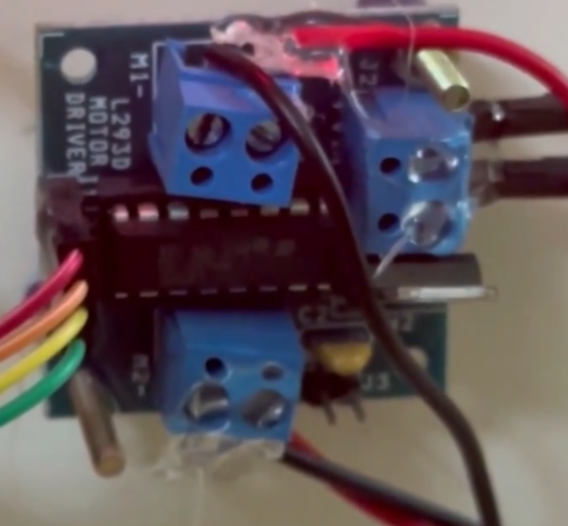
Hardware Requirements
L293D motor driver
Versatile Motor Control: L293D drives DC/stepper motors.
Dual H-Bridge Design: Controls two motors independently.
Wide Voltage Range: Operates from 4.5V to 36V.
Current Capacity: Handles up to 600mA peak.
Thermal Protection: Safeguards against overheating.
Inductive Spike Protection: Built-in diodes for voltage stability.
Seamless Integration: Pairs with Arduino Due for smart manoeuvring.
Wheelchair Mobility: Powers precise, independent wheel movement.

Slide 12
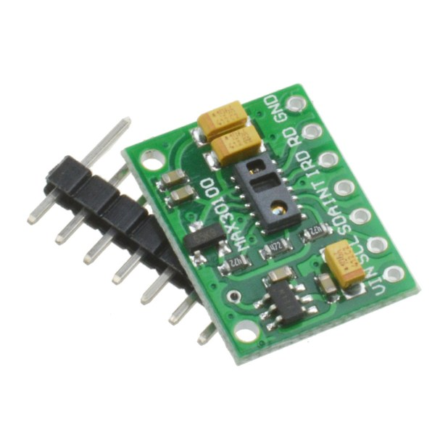
Hardware Requirements
MAX30100 heartbeat sensor
Compact Integration: MAX30100 combines pulse oximetry and heart rate monitoring.
Dual LED System: Uses red and infrared LEDs for accurate measurements.
Optimized Optics: Ensures precise signal capture from the blood.
Analog Signal Processing: Low-noise operation for robust noise rejection.
I2C Communication: Compatible with Arduino for seamless data transfer.
Low Power Consumption: Ideal for wearable health technology.
Non-Intrusive Monitoring: Suitable for continuous health tracking in a wheelchair.

Slide 13
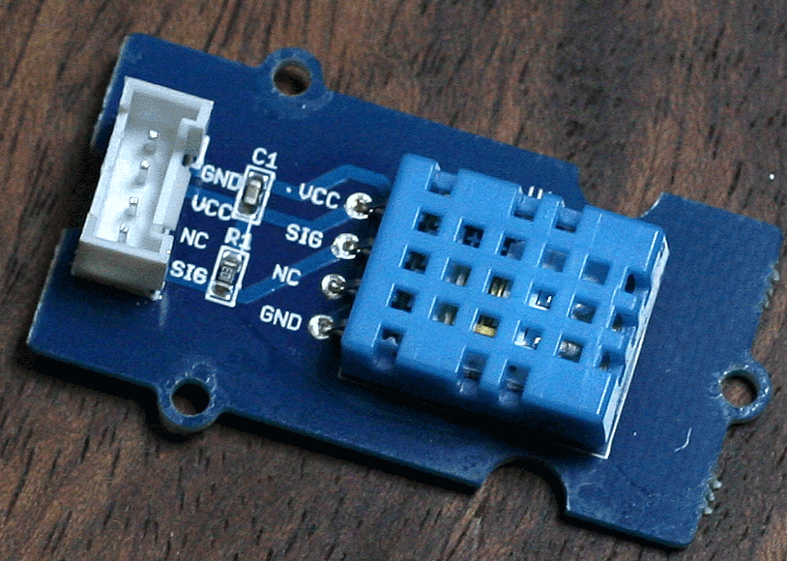
Hardware Requirements
DHT11 Temperature sensor
DHT11 Sensor: Digital sensor for temperature and humidity.
User Comfort: Monitors environmental conditions.
Low Power Consumption: Efficient for continuous operation.
Simple Interface: Easy integration with Arduino Due.
Operational Range: Works within 3-5V.
Digital Output: Provides direct readings to the microcontroller.
Incorporated in Smart Wheelchair: Enhances user experience by maintaining ambient comfort.

Slide 14
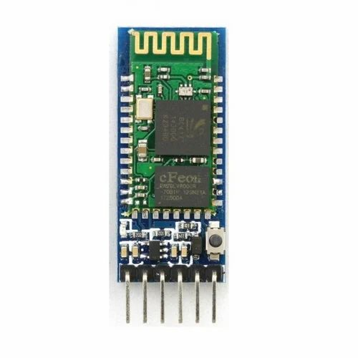
Hardware Requirements
HC-05 Bluetooth module
Bluetooth Integration: HC-05 module for wireless connectivity.
Versatile Communication: Operates in both master and slave modes.
Microcontroller Interface: UART interface for easy Arduino connection.
Range and Baud Rates: Effective 10-meter range, adjustable baud rates (1200 to 1382400 bps).
User Control: Facilitates remote operation and data exchange.
Enhanced Interaction: Improves user experience with wireless control.

Slide 15
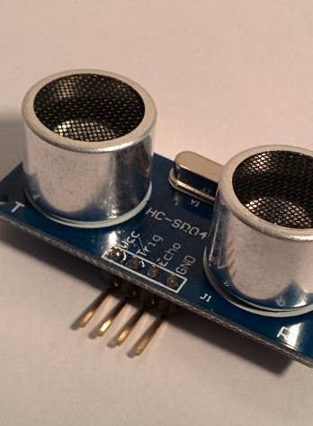
Hardware Requirements
Ultrasonic sensor
HC-SR04 Ultrasonic Sensor: Essential for distance measurement and object detection.
Non-Contact Measurement: Utilizes ultrasonic waves for safe distance gauging.
Distance Range: Measures from 2cm to 400cm with ±3mm accuracy.
Operation Frequency: Works at a 40kHz frequency.
Voltage Range: Operates within a 5V range.
Safety Feature: Crucial for the smart wheelchair’s obstacle avoidance system.
Cost-Effective Solution: Offers reliable functionality at a low cost.
Application: Integrated in wheelchair for indoor navigation and collision prevention.

Slide 16
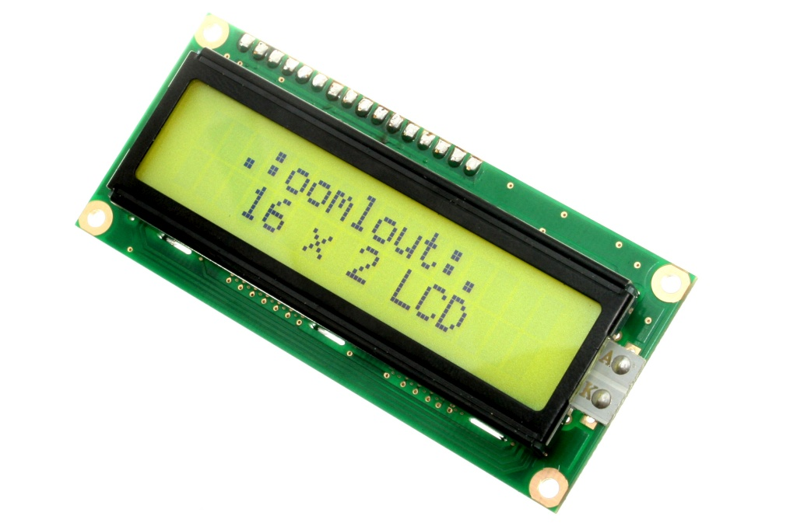
Hardware Requirements
Display LCD
16x2 LCD Display: Displays 32 characters across 2 lines.
Alphanumeric & Monochrome: Ideal for clear, concise information display.
HD44780 Controller: Standardized interfacing and programming.
Adjustable Contrast: For optimal readability in various lighting.
Low Power Use: Efficient for continuous operation.
User Interface: Shows health data, navigation info on wheelchair.
Simple Integration: Easily connects to Arduino Due.

Slide 17
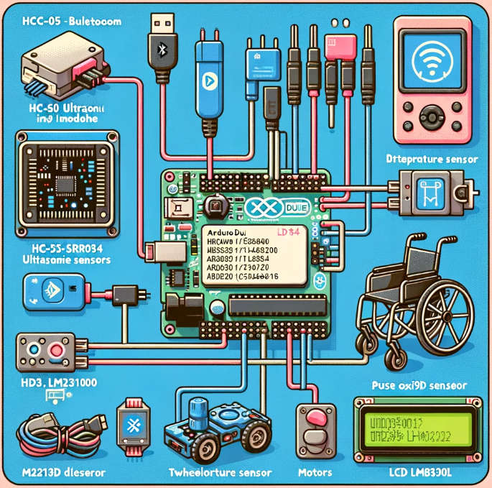
IMPLEMENTATION
Hardware Implementation
Utilize Arduino Due for central control.
Integrate sensors for safety and health monitoring.
Employ Bluetooth for connectivity.
Implement motor drivers for mobility.
Software Simulation
Develop algorithms for sensor data analysis.
Create control logic for movement and navigation.
Design interfaces for remote operation and display.
Establish protocols for emergency health alerts.

Slide 18

SOFTWARE SIMULATION
Arduino IDE
Proteus simulation software
SOFTWARES REQUIRED
CODING LANGUAGES
Embedded C

Slide 19
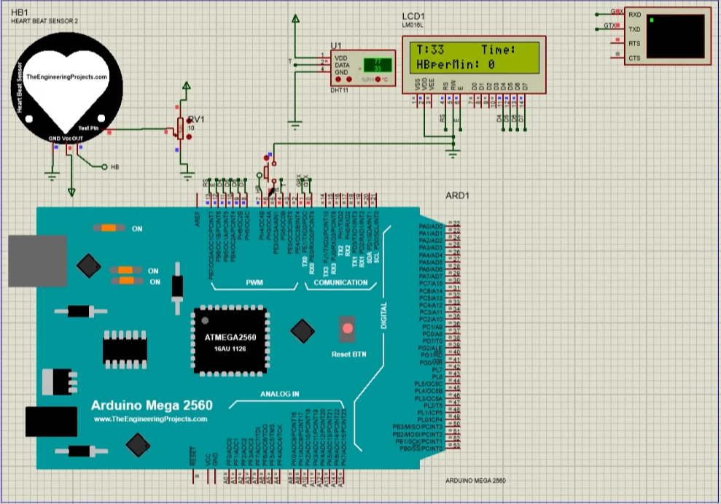
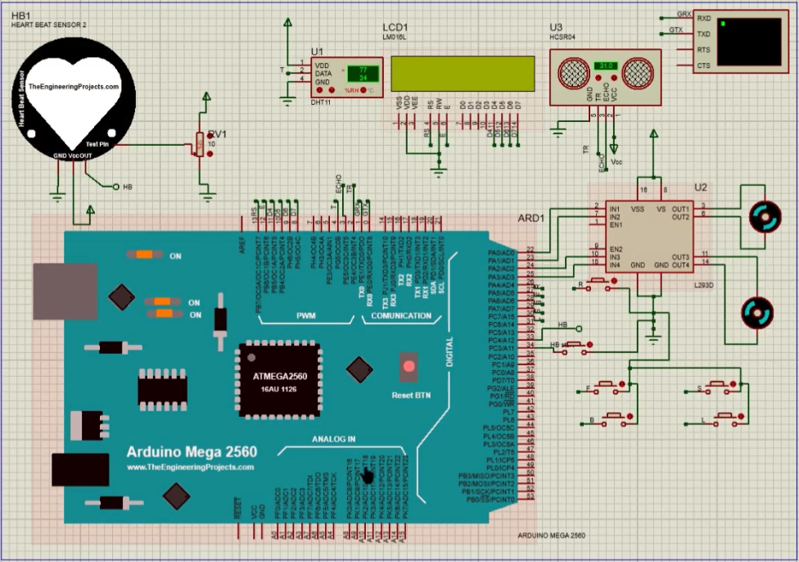
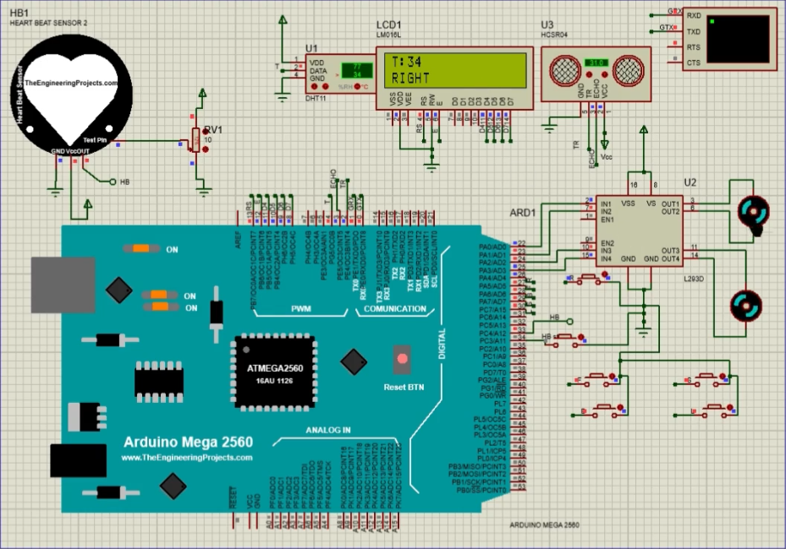
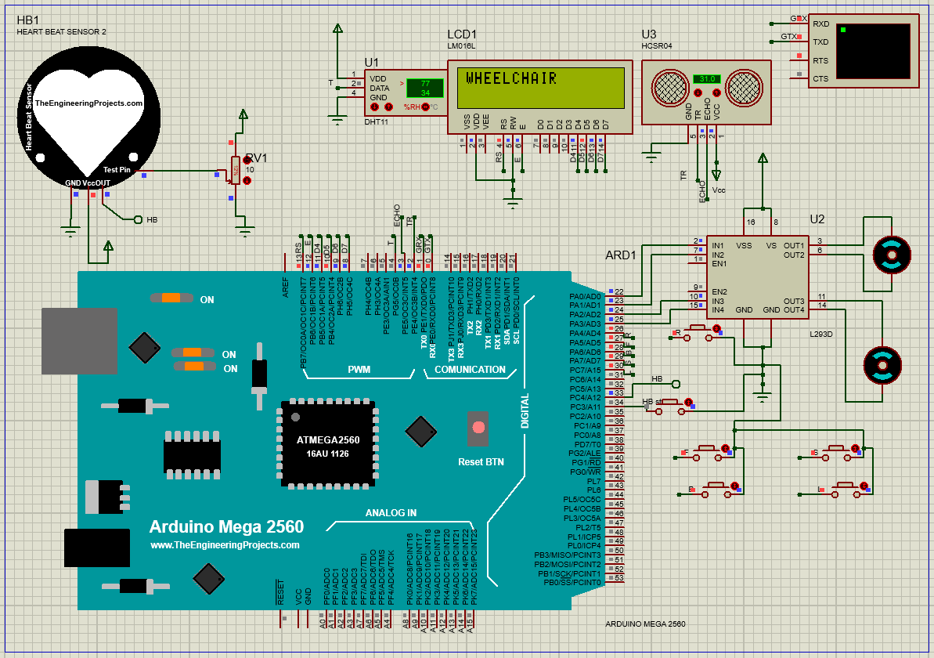
SOFTWARE DESIGN
Proteus Simulations: Conducted extensive tests for system validation.
Sensor Accuracy Testing: Assessed HC-SR04 for precise obstacle detection.
Navigational Algorithm Evaluation: Tested effectiveness of movement algorithms.
Bluetooth Module Reliability: Ensured seamless HC-05 communication.
Sensor Data Integration: Synthesized readings from various sensors effectively.
Challenge Resolution: Addressed issues like Bluetooth data latency.
System Design Improvements: Enhanced overall design and functionality.
Successful Outcomes: Demonstrated high accuracy in sensor readings.
Software Refinement: Guided by simulations for optimal performance.

Slide 20
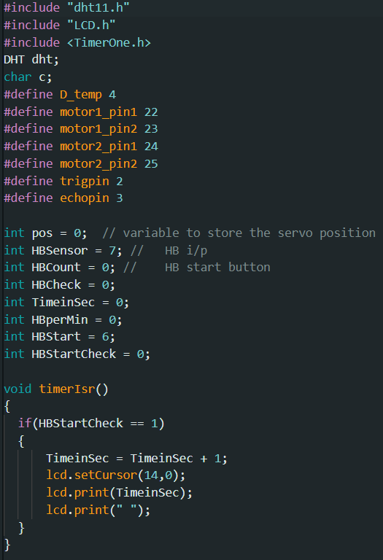
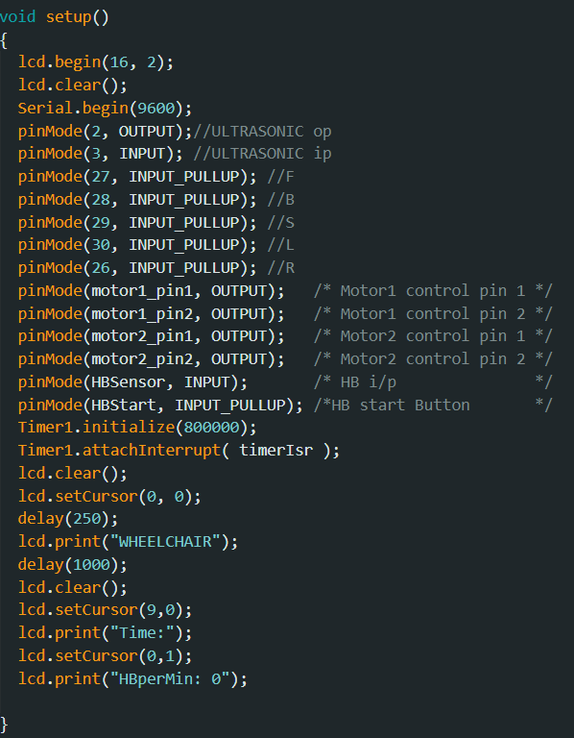
SIMULATION SETUP
Setup Code Section

Slide 21
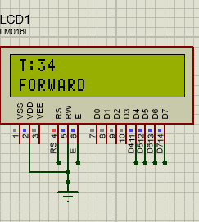
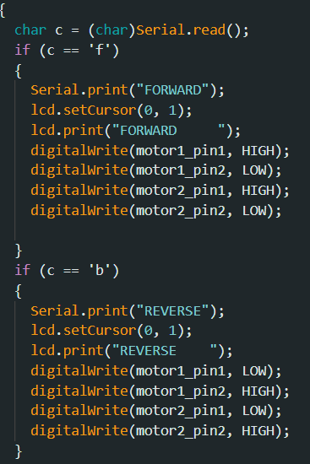
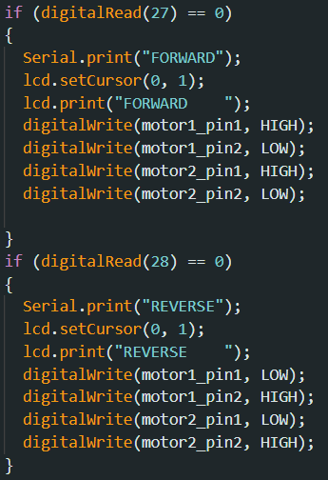
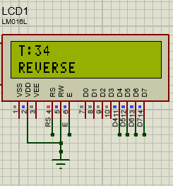
SIMULATION RESULTS
Direction Operation Results
Bluetooth Connectivity – Pin allotment function as a button in proteus
Forward and Reverse
Directional Operation

Slide 22
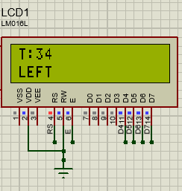
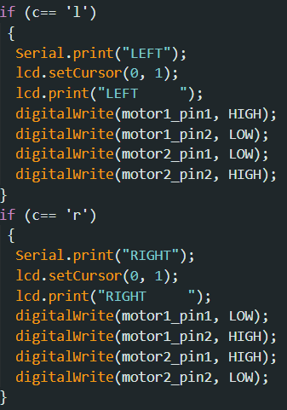
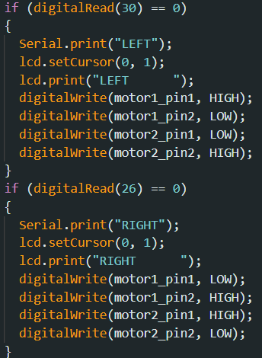
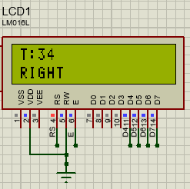
SIMULATION RESULTS
Direction Operation Results
Bluetooth Connectivity – Pin allotment function as a button in proteus
Turn
Directional Operations

Slide 23
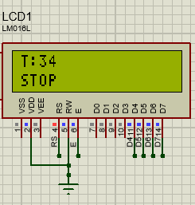
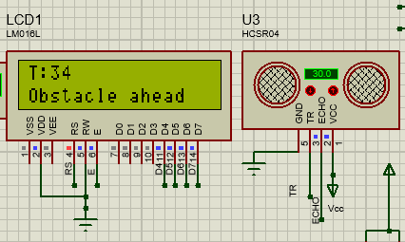
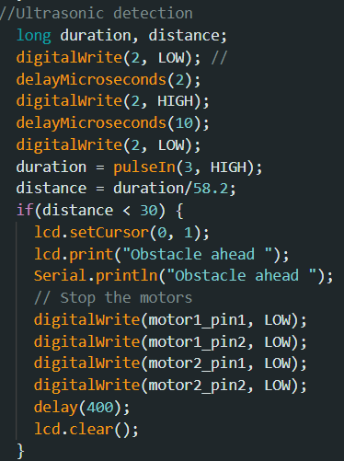
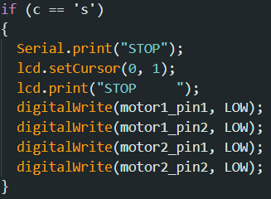
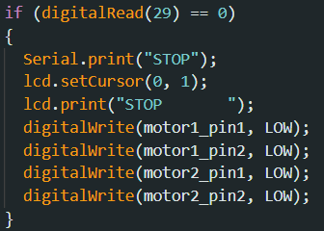
SIMULATION RESULTS
Stop Function with Obstacle detection
Bluetooth Connectivity – Pin allotment function as a button in proteus

Slide 24
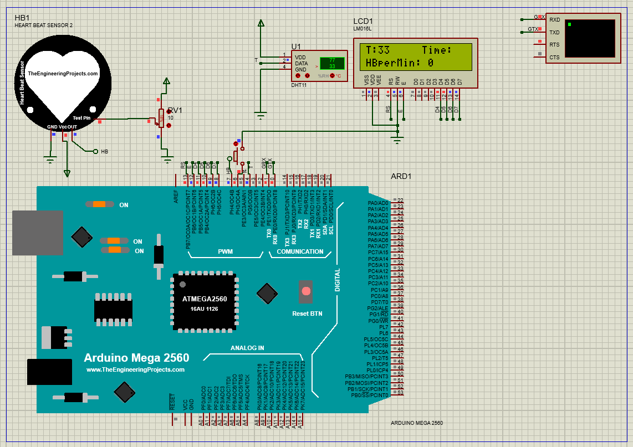

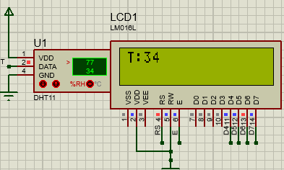
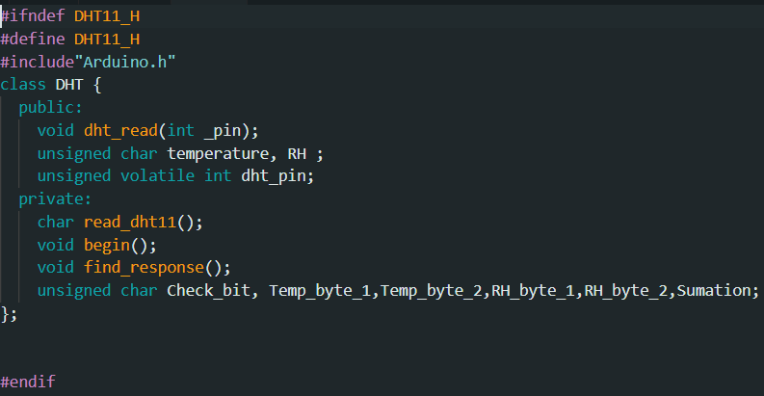
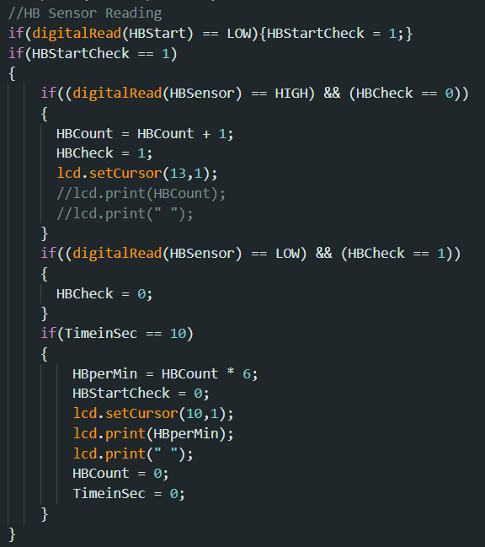
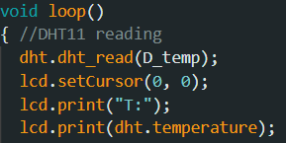
SIMULATION RESULTS
Health System Results

Slide 25
HARDWARE IMPLEMENTATION
Arduino Due: Central processor for data handling and command execution.
Ultrasonic Sensor (HC-SR04): Provides non-contact obstacle detection for user safety.
Temperature Sensor (DHT11): Monitors environmental conditions for user comfort.
Heartbeat Sensor (MAX30100): Tracks heart rate and blood oxygen saturation for health monitoring.
Bluetooth Module (HC-05): Enables wireless communication for control and data transfer.
Motor Driver (L293D): Controls the wheelchair's motors for movement and navigation.
LCD Display (LM016L): Offers a user interface to display health and navigation information.
*Due to Library and Code Compatibility, arduino libraries or code snippets are specifically written for AVR-based boards (like the Mega 2560 used in proteus) and may not be directly compatible with ARM-based boards like the Due without modifications. Accordingly, code modifications are done for the hardware prototype to support for compatibility and also particularly for MAX30100 sensor. Hardware code attached in Appendix (slide 33).

Slide 26
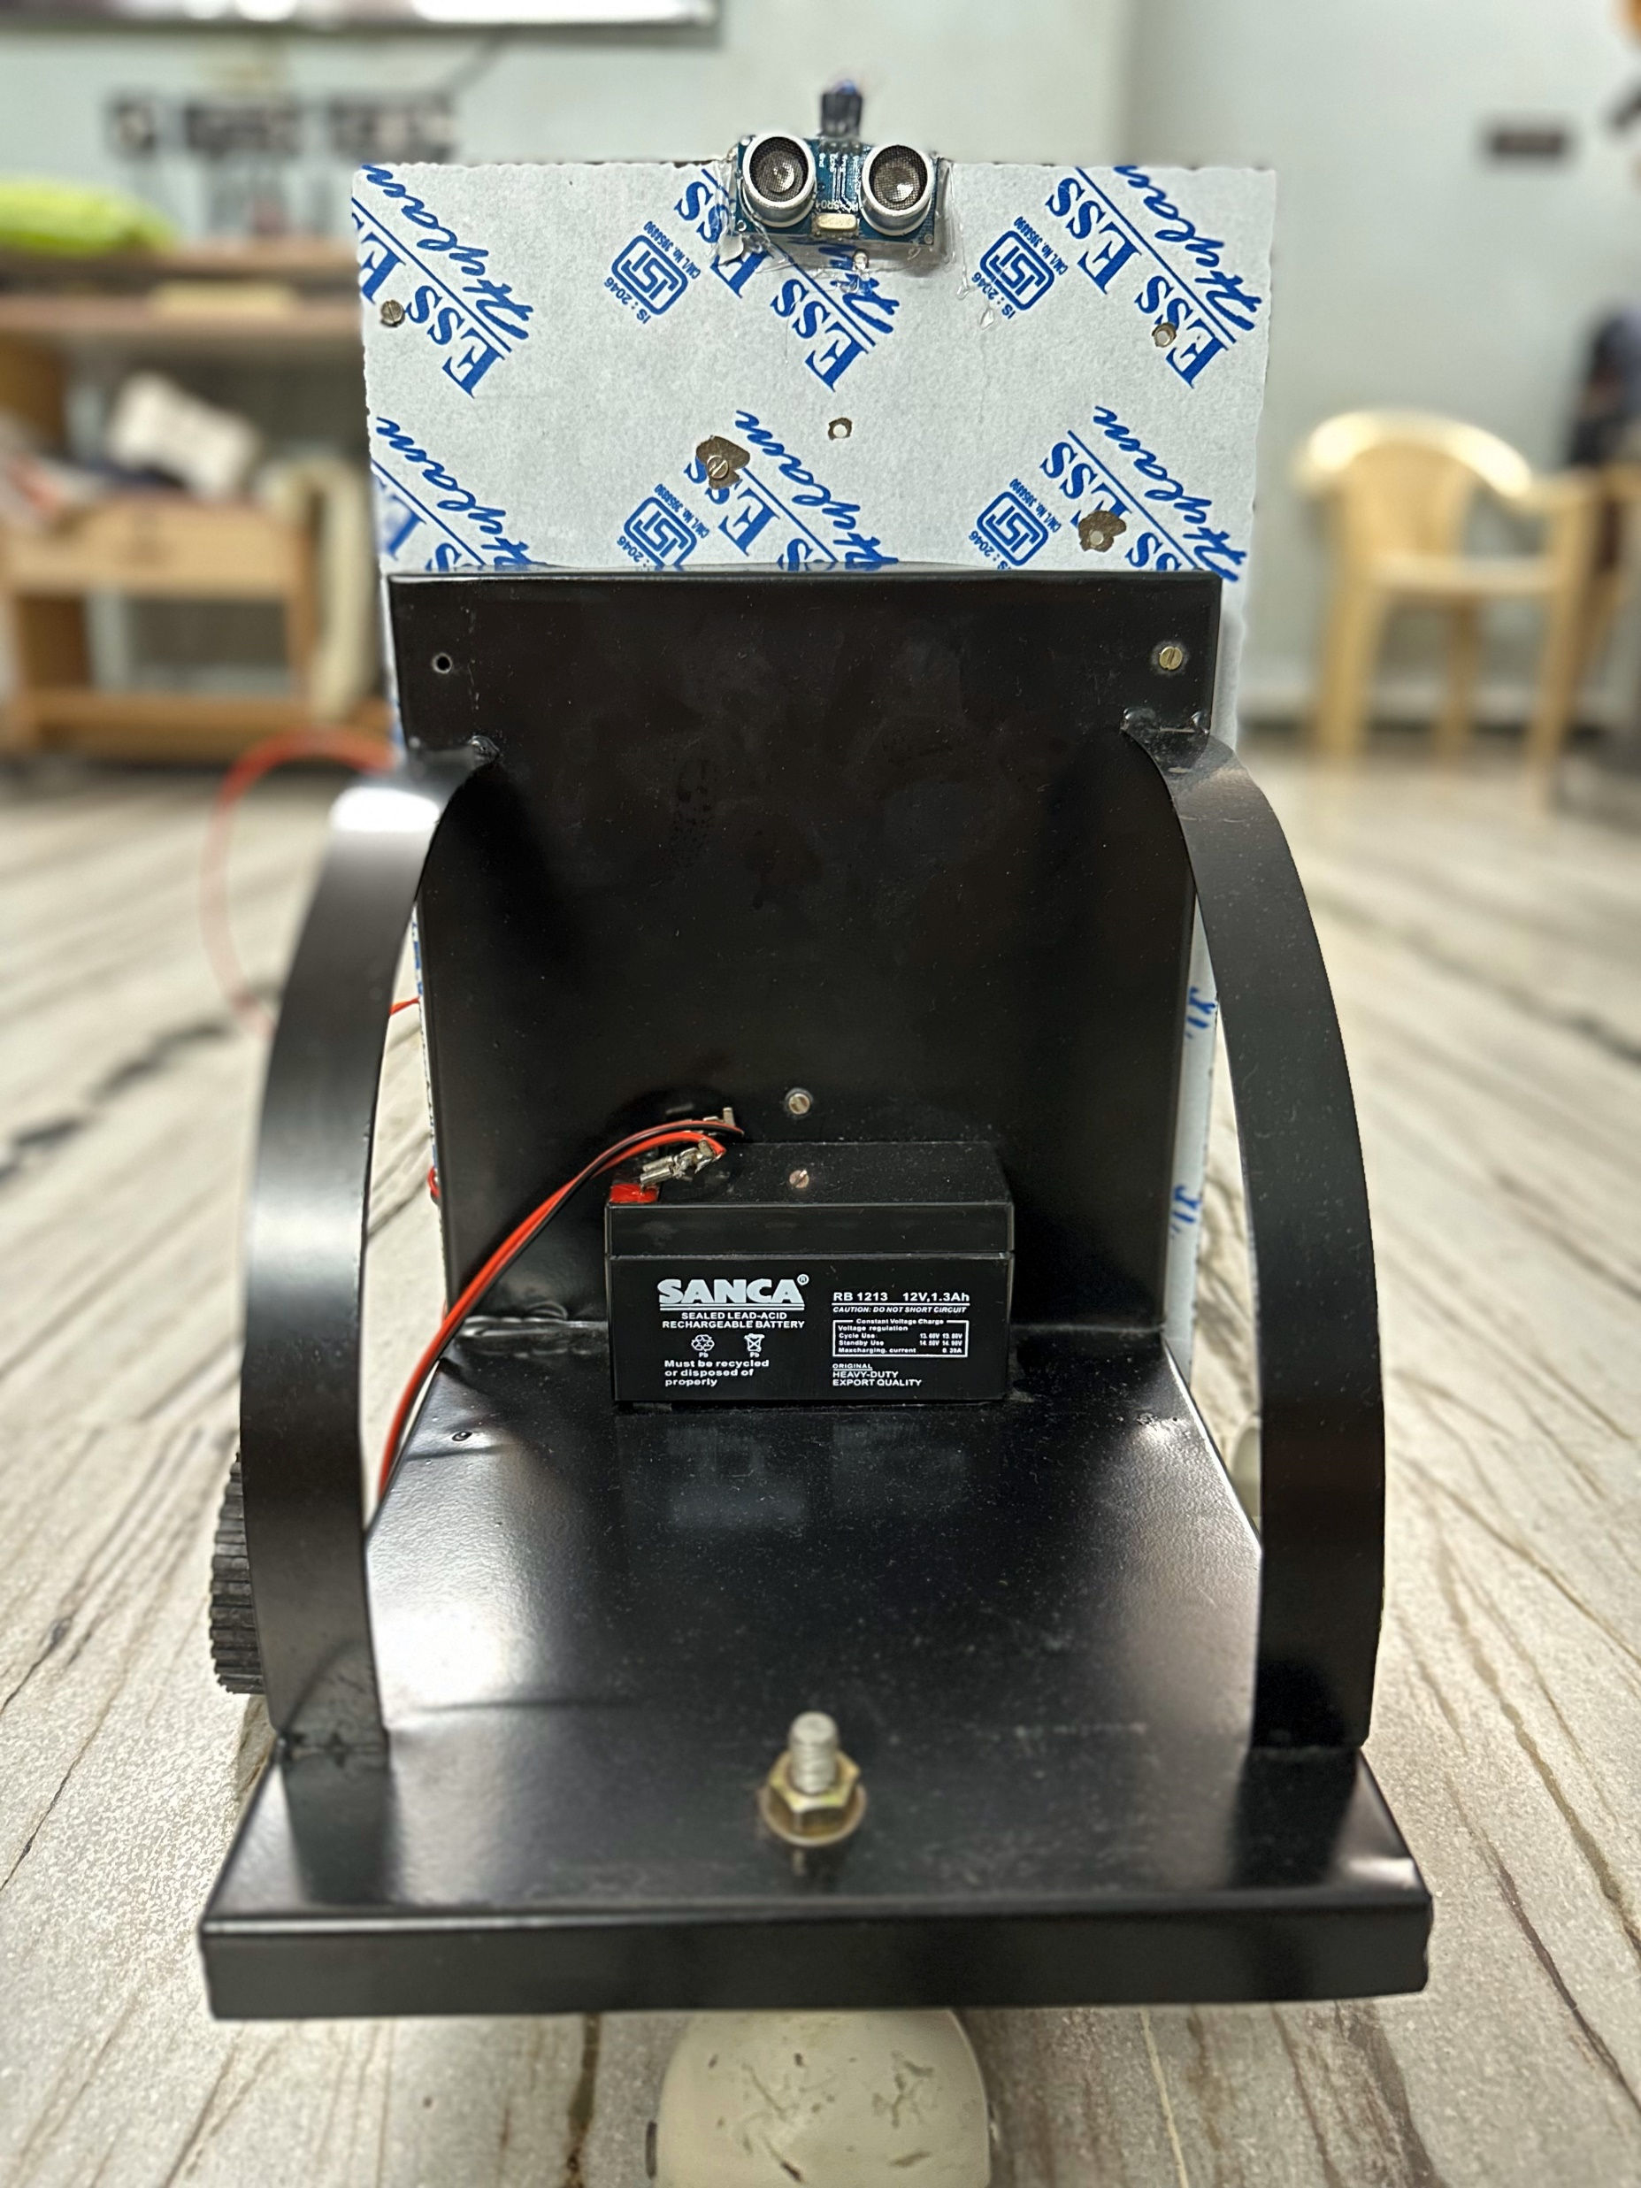

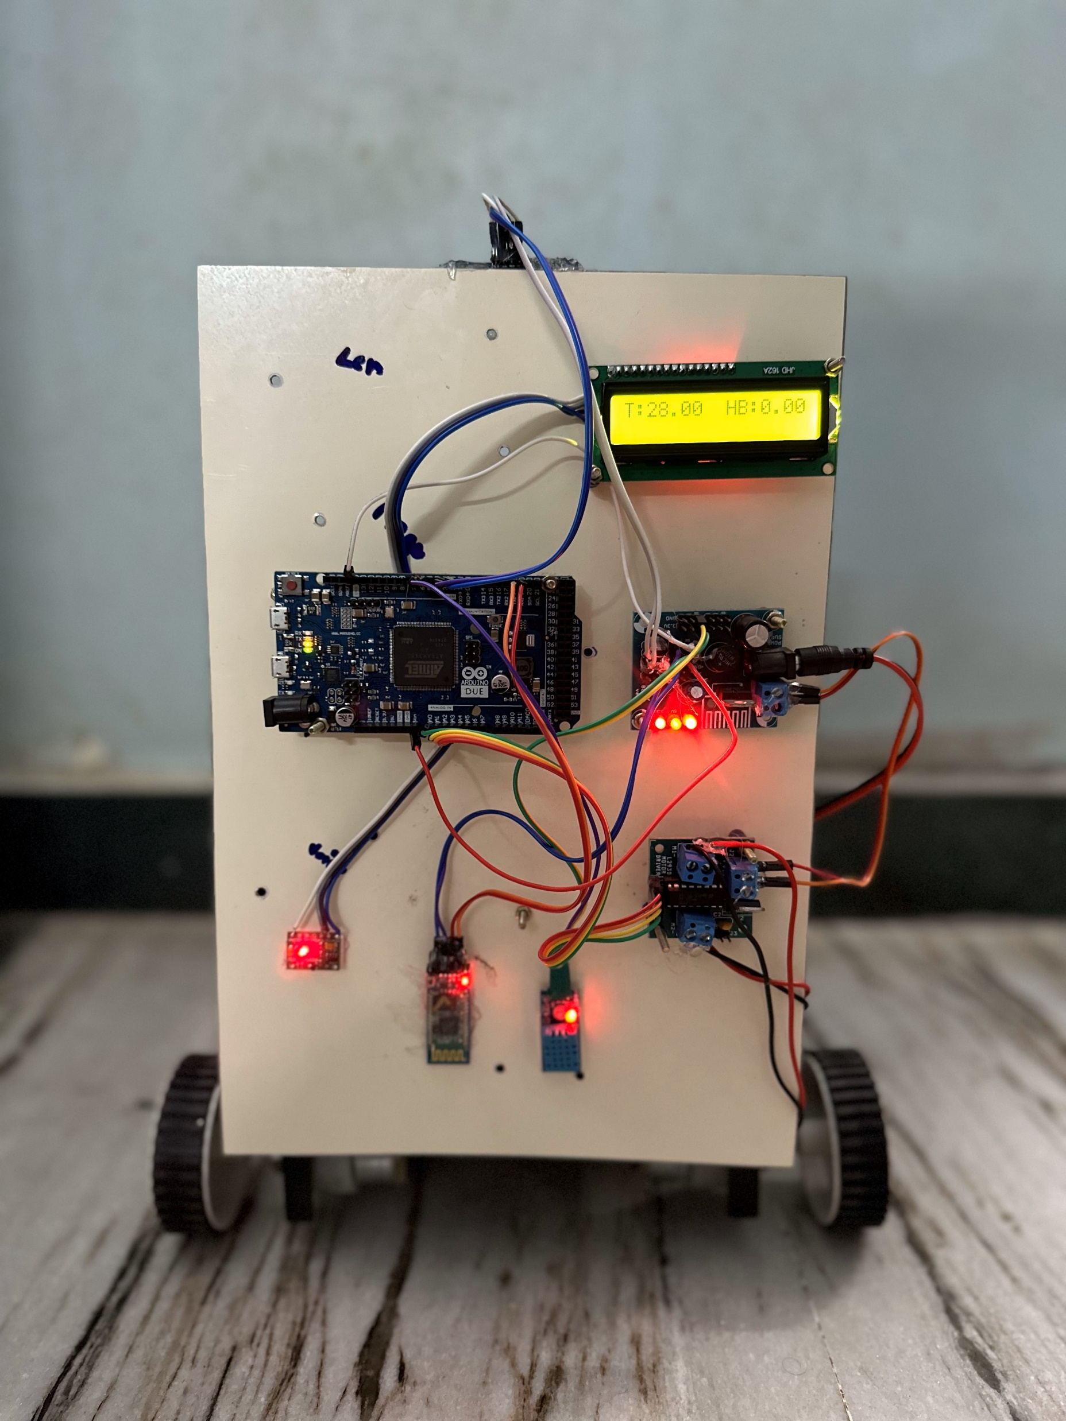
Hardware Setup
Central Control: Arduino Due as the system's core processor.
Obstacle Detection: HC-SR04 ultrasonic sensor integration.
Wireless Operation: HC-05 Bluetooth module for control and communication.
Health Monitoring: MAX30100 pulse oximeter for vital sign tracking.
Integration Challenges: Addressed robustness and compactness in design.
Seamless Component Integration: Achieved through iterative testing.
Strategic Component Placement: Ensures intuitive user experience.
Balance of Functionality and Comfort: Combining advanced technology with user needs.

Slide 27
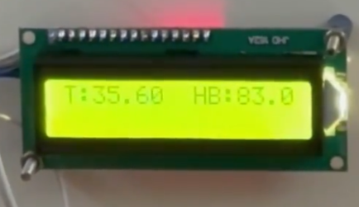
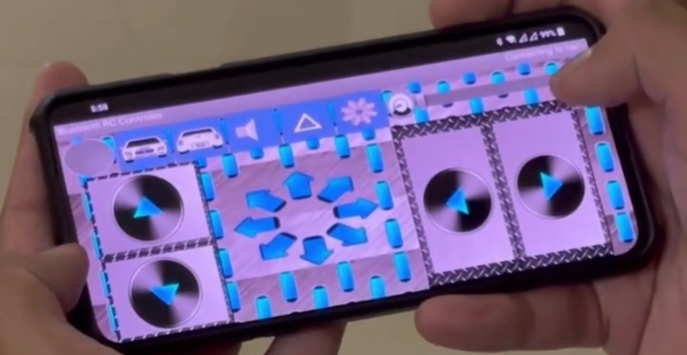
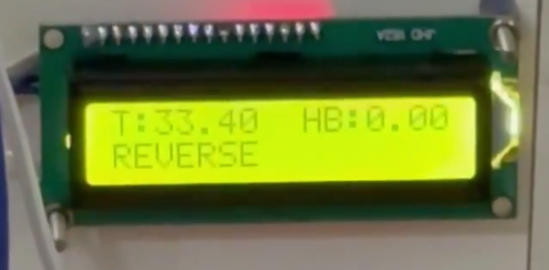
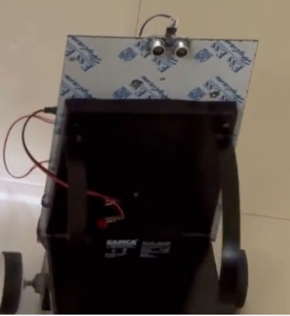
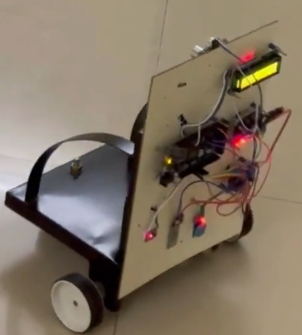
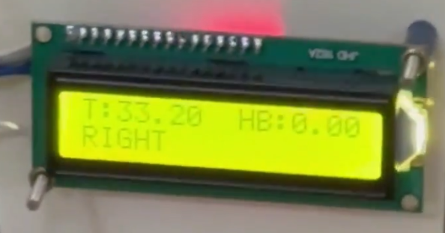
Results
Successful Navigation: Demonstrated precise obstacle avoidance with HC-SR04 sensor.
Health Monitoring: MAX30100 sensor accurately tracked heart rate and blood oxygen levels.
Remote Control Efficiency: HC-05 Bluetooth module ensured seamless connectivity.
Responsive Movement: L293D motor driver enabled smooth wheelchair control.
Comparative Analysis: Showcased superior performance against existing benchmarks.
Sensor Calibration: Addressed initial challenges for enhanced accuracy.
Positive Observer Feedback: Highlighted intuitive controls and smooth operation.
Refinement and Improvements: Continuous system enhancements based on test results.

Slide 28
DEMONSTRATION VIDEO
Video presentation link - Google Drive

Slide 29
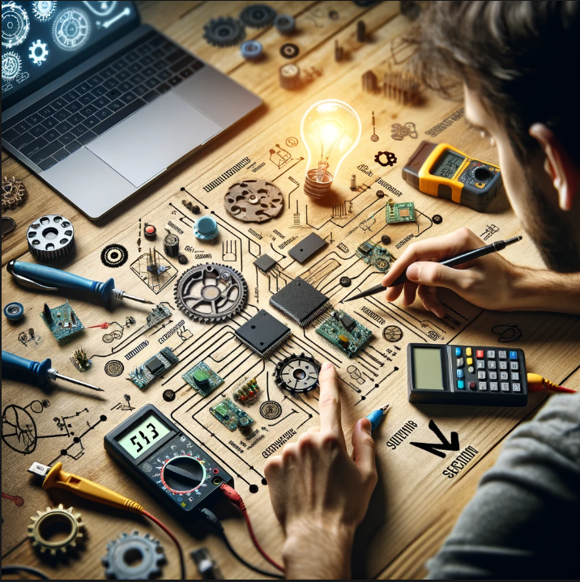
Challenges and Learnings
HC-SR04 Calibration: Addressed environmental impact on sensor accuracy.
Bluetooth Connectivity: Solved stability issues in crowded signal areas.
Microcontroller Integration: Managed Arduino Due's 3.3V operating challenge.
Voltage Compatibility: Adapted components to Arduino's voltage requirements.
Technical Resilience: Improved expertise through overcoming hurdles.
Innovative Problem-Solving: Fostered creativity in technical solutions.
Iterative Development: Refined design through continuous testing.
User-Centric Design Approach: Balanced technology with functionality.

Slide 30
RESULT COMPARISON WITH REFERENCES
Feature | Your Project | Autonomous Driving Robot Wheelchairs | Wireless Gesture-Controlled Wheelchair | Smart Wheelchair for Aged People
Health Monitoring | Yes (Temperature, humidity, heart rate, SpO2) | Not mentioned | No | Yes
Microcontroller | Arduino Due | Not specified | Arduino Uno | Arduino Uno and Raspberry Pi
Autonomous Navigation | Yes (Ultrasonic sensors for obstacle avoidance) | Yes | No | Not primarily
User Interface | LCD Display for real-time data display | Not specified | No | No
Comprehensive Mobility Solution | Yes (Beyond mobility aid), gyroscope of phone interfaced with bluetooth. | Autonomous driving focus | Focus on gesture control | Health monitoring focus
Obstacle Detection Safety | Yes (HC-SR04 Ultrasonic Sensor) | Yes (Ultrasonic sensors) | No | Not primarily
Processing Power and Flexibility | High (Arduino Due) | Not specified | Moderate (Arduino Uno) | Moderate (Arduino Uno)

Slide 31
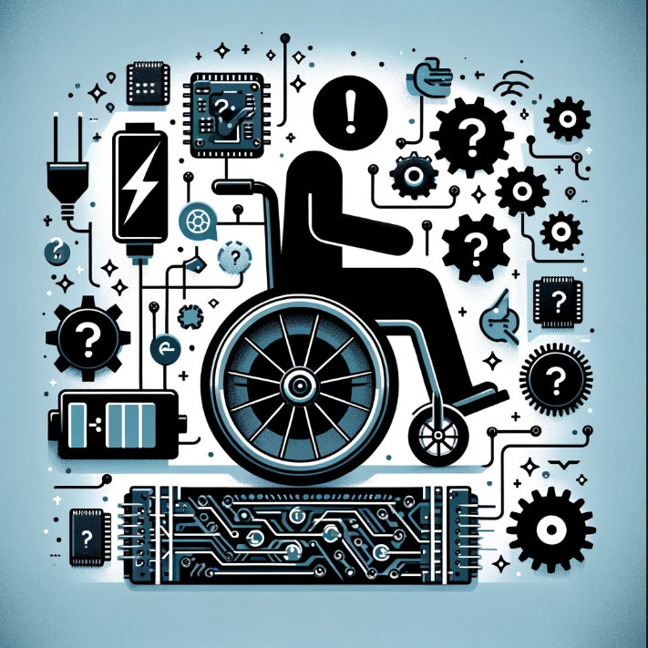
LIMITATIONS
Hardware Limitations: Arduino Due's processing and memory constraints.
Battery Demand: High power use by sensors and Bluetooth.
Bluetooth Range: Susceptibility to interference and range limits.
Sensor Precision: Accuracy issues with DHT11 and MAX30100.
Size and Weight: Impact on wheelchair's manoeuvrability.
Complex Interface: Challenges for elderly or impaired users.
Increased Costs: Due to advanced technology integration.
Environmental Sensitivity: Affected by extreme weather.
Maintenance Needs: Higher due to system complexity.
Data Security Concerns: Risks with health data privacy.
Regulatory Hurdles: Compliance with health standards.
Software Updates: Need for regular maintenance.

Slide 32

Future Scope
AI-Enhanced Navigation: Personalized, adaptive wheelchair control.
IoT Health Monitoring: Real-time data analysis and remote access.
Advanced Health Sensors: Incorporate ECG and blood pressure monitoring.
Home Automation: Controlling household products with Iot.
Voice Command Interface: For ease of control and accessibility.
GPS Navigation: Outdoor pathfinding with app integration.
Fall Detection System: Immediate alerts and emergency response.
Autonomous Movement: Independent navigation with advanced technology.
Energy Efficiency: Solar charging and improved battery life.
User Interface: Intuitive controls with touch and AR technology.
Personalization: Custom settings for comfort and convenience.
Telepresence: Remote interaction for enhanced social engagement.
Smart Home Integration: Wheelchair control over home devices.

Slide 33

Conclusion
Assistive Technology Advance: Demonstrated a leap forward in assistive devices.
Bluetooth and Health Integration: Successfully integrated with Arduino Due.
Enhanced Mobility: Delivered a highly functional mobility aid.
Health Monitoring: Included vital health tracking for user safety.
User-Friendly Design: Showcased a user-centric mobility solution.
Potential for Technology: Highlighted real-world application of advanced electronics.
Future Development: AI and ML for navigation, IoT for health data, and voice control.
Commitment to Innovation: Focused on continuous improvement and user support.
33
33

Slide 34
References
[1] S. -J. Kim, J. Park, Y. Na and H. Won, "Autonomous Driving Robot Wheelchairs for Smart Hospitals," 2022 IEEE International Conference on Consumer Electronics-Asia (ICCE-Asia), Yeosu, Korea, Republic of, 2022, pp. 1-2, doi: 10.1109/ICCE-Asia57006.2022.9954833.
[2] P N, Sudha & Ghorpade, Suraj & Bhatt, Vrindha. (2023). A Smart Wheelchair for Aged People with Health- Monitoring System. 10.35291/2454-9150.2021.0389.
[3] R. K. Megalingam, S. Sreekanth, A. Govardhan, C. R. Teja and A. Raj, "Wireless gesture-controlled wheelchair," 2017 4th International Conference on Advanced Computing and Communication Systems (ICACCS), Coimbatore, India, 2017, pp. 1-5, doi: 10.1109/ICACCS.2017.8014621.
[4] J. R. Wolpaw, N. Birbaumer, W. J. Heetderks, D. J. McFarland, P. H. Peckham, G. Schalk, E. Donchin, L. A. Quatrano, C. J. Robinson, and T. M. Vaughan, “Brain-computer interface technology: a review of the first international meeting,” IEEE transactions on rehabilitation engineering, vol. 8, no. 2, pp. 164–173, 2000.
[5] R. Zhang, Y. Li, Y. Yan, H. Zhang, S. Wu, T. Yu, and Z. Gu, “Control of a wheelchair in an indoor environment based on a brain-computer interface and automated navigation,” IEEE transactions on neural systems and rehabilitation engineering, vol. 24, no. 1, pp. 128–139, 2015.
[6] H. Wang, X. Dong, Z. Chen, and B. E. Shi, “Hybrid gaze/EEG brain-computer interface for robot arm control on a pick and place task,” in 2015 37th Annual International Conference of the IEEE Engineering in Medicine and Biology Society (EMBC). IEEE, 2015, pp. 1476– 1479.
[7] L.-D. Liao, C.-Y. Chen, I.-J. Wang, S.-F. Chen, S.-Y. Li, B.-W. Chen, J.-Y. Chang, and C.-T. Lin, “Gaming control using a wearable and wireless EEG-based brain-computer interface device with novel dry foam-based sensors,” Journal of neuroengineering and rehabilitation, vol. 9, no. 1, p. 5, 2012.
[8] K. LaFleur, K. Cassady, A. Doud, K. Shades, E. Rogin, and B. He, “Quadcopter control in three-dimensional space using a noninvasive motor imagery-based brain-computer interface,” Journal of neural engineering, vol. 10, no. 4, p. 046003, 2013.
[9] J. KKevinand A. Subasi, “Comparison of signal decomposition methods in classification of EEG signals for motor-imagery BCI system,” Biomedical Signal Processing and Control, vol. 31, pp. 398–406, 2017. 30
[10] M. Pal and S. Bandyopadhyay, “Many-objective feature selection for motor imagery EEG signals using differential evolution and support vector machine,” in 2016 International Conference on Microelectronics, Computing, and Communications (MicroCom). IEEE, 2016, pp. 1–6.
[11] S. Bhattacharyya, P. Rakshit, A. Konar, D. Tibarewala, and R. Janarthanan, “Feature selection of motor image signals using firefly temporal difference q-learning and support vector machine,” in International Conference on Swarm, Evolutionary, and Memetic Computing. Springer, 2013, pp. 534–545.
[12] V. Jayaram, M. Alamgir, Y. Altun, B. Scholkopf, and M. Grosse-Wentrup, “Transfer learning in braincomputer interfaces,” IEEE Computational Intelligence Magazine, vol. 11, no. 1, pp. 20–31, 2016.
[13] W.-L. Zheng, Y.-Q. Zhang, J.-Y. Zhu, and B.-L. Lu, “Transfer components between subjects foreign-based emotion recognition,” in 2015 International Conference on Affective Computing and Intelligent Interaction (ASCII). IEEE, 2015, pp. 917–922
34

Slide 35
Appendix
Arduino Sketch:
#include <Wire.h>
#include "MAX30100_PulseOximeter.h"
#include <LiquidCrystal_I2C.h>
#include <Adafruit_Sensor.h>
#include <DHT.h>
#include <DHT_U.h>
#define DHTPIN 6
#define DHTTYPE DHT11
DHT_Unified dht(DHTPIN, DHTTYPE);
uint32_t delayMS;
LiquidCrystal_I2C lcd(0x27,16,2);
#define REPORTING_PERIOD_MS 1000
const int trigPin = 2;
const int echoPin = 3;
MAX30100 sensor;
int a;
// Create a PulseOximeter object
PulseOximeter pox;
long duration;
int distance;
// Time at which the last beat occurred
uint32_t tsLastReport = 0;
void setup() {
pinMode(trigPin, OUTPUT); // Sets the trigPin as an Output
pinMode(echoPin, INPUT);
pinMode(A0,OUTPUT);
pinMode(A1,OUTPUT);
pinMode(A2,OUTPUT);
pinMode(A3,OUTPUT);
Serial.begin(9600);
Serial1.begin(9600);
dht.begin();
sensor_t sensor1;
dht.temperature().getSensor(&sensor1);
dht.humidity().getSensor(&sensor1);
delayMS = sensor1.min_delay / 1000;
lcd.init();
lcd.init();
lcd.backlight();
if (!pox.begin()) {
Serial.println("FAILED");
for(;;);
} else {
Serial.println("SUCCESS");
}
pox.setIRLedCurrent(MAX30100_LED_CURR_7_6MA);
pox.setOnBeatDetectedCallback(onBeatDetected);
}
void loop() {
pox.update();
if (millis() - tsLastReport > REPORTING_PERIOD_MS) {
Serial.print("Heart rate:");
Serial.print(pox.getHeartRate());
Serial.print("bpm / SpO2:");
Serial.print(pox.getSpO2());
Serial.println("%");
sensors_event_t event;
dht.temperature().getEvent(&event);
lcd.clear();
lcd.setCursor(0,0);
lcd.print("T: ");
lcd.setCursor(2,0);
lcd.print(event.temperature);
lcd.setCursor(9,0);
lcd.print("HB: ");
lcd.setCursor(12,0);
lcd.print(pox.getHeartRate());
while(Serial1.available())
{
char t=Serial1.read();
//Serial.println(t);
if(t=='F')
{
Serial.println("FORWARD");
digitalWrite(trigPin, LOW);
delayMicroseconds(2);
digitalWrite(trigPin, HIGH);
delayMicroseconds(10);
digitalWrite(trigPin, LOW);
duration = pulseIn(echoPin, HIGH);
distance= duration*0.034/2;
if(distance>15)
{
digitalWrite(A0,LOW);
digitalWrite(A1,HIGH);
digitalWrite(A2,LOW);
digitalWrite(A3,HIGH);
lcd.setCursor(0,1);
lcd.print("FORWARD");
pox.begin();
pox.setIRLedCurrent(MAX30100_LED_CURR_7_6MA);
pox.setOnBeatDetectedCallback(onBeatDetected);
}
if(distance<15)
{
digitalWrite(A0,LOW);
digitalWrite(A1,LOW);
digitalWrite(A2,LOW);
digitalWrite(A3,LOW);
}
}
if(t=='B')
{
digitalWrite(A0,HIGH);
digitalWrite(A1,LOW);
digitalWrite(A2,HIGH);
digitalWrite(A3,LOW);
lcd.setCursor(0,1);
lcd.print("REVERSE");
pox.begin();
pox.setIRLedCurrent(MAX30100_LED_CURR_7_6MA);
pox.setOnBeatDetectedCallback(onBeatDetected);
}
if(t=='R')
{
digitalWrite(A0,LOW);
digitalWrite(A1,HIGH);
digitalWrite(A2,HIGH);
digitalWrite(A3,LOW);
lcd.setCursor(0,1);
lcd.print("RIGHT");
pox.begin();
pox.setIRLedCurrent(MAX30100_LED_CURR_7_6MA);
pox.setOnBeatDetectedCallback(onBeatDetected);
}
if(t=='L')
{
digitalWrite(A0,HIGH);
digitalWrite(A1,LOW);
digitalWrite(A2,LOW);
digitalWrite(A3,HIGH);
lcd.setCursor(0,1);
lcd.print("LEFT");
pox.begin();
pox.setIRLedCurrent(MAX30100_LED_CURR_7_6MA);
pox.setOnBeatDetectedCallback(onBeatDetected);
}
if(t=='S')
{
digitalWrite(A0,LOW);
digitalWrite(A1,LOW);
digitalWrite(A2,LOW);
digitalWrite(A3,LOW);
// lcd.setCursor(0,1);
// lcd.print("STOP");
}
}
tsLastReport = millis();
}
}
void configureMax30100() {
sensor.setMode(MAX30100_MODE_SPO2_HR);
sensor.setLedsCurrent(MAX30100_LED_CURR_50MA, MAX30100_LED_CURR_27_1MA);
sensor.setLedsPulseWidth(MAX30100_SPC_PW_1600US_16BITS);
sensor.setSamplingRate(MAX30100_SAMPRATE_100HZ);
sensor.setHighresModeEnabled(true);
}

Slide 36

Thank You Sincere Gratitude: To our esteemed Professor and dedicated Course Support Staff. Special thanks to Dr. Fadi El Hassan for understanding a difficult circumstance of one of our group member and granting extensions to support him in the difficult times. Unwavering Support: For your continuous guidance and invaluable technical expertise. Inspirational Encouragement: For motivating us to push boundaries and innovate further. We are deeply appreciative of your contributions to our journey.
36
36

